Slide 1

Private Cloud Appliance X9
PCA X9 Technical Features and Architecture Storyboard
PCA/PCC Product Management

Slide 2


SQL> select * from person where name = ‘Marcel Lamarca’
Father, Caipira , husband, Cooker and son!
Graduated in Business Administration (FMU-SP)
Oracle DBA
20 year dedicated to study and support Oracle Databases.
7 years working with Exadata (On-prem, C@C and Cloud Services) .
About to complete 3 years at Oracle helping Customers and partners to cloud
Oracle Latino-américa Alliances & Channels since 2022
Last book: “ I ‘am Ozzy”
Oracle Certified Professional (OCP)
10g, 11g and 12c.
Oracle Certified Specialist (OCE)
GRID/RAC Database Administrator
OCI Foundation
Oracle Autonomous Database Administrator.
Oracle Cloud Database Migration and Integration
Next-steps: Always looking to become a better person
Notes:
- Falar um pouco sobre minha carreira e chamar o Alê para fazer a dele e em seguinda já chamar o André

Slide 3


SQL> select * from person where name = ‘Alexandre Fagundes’
 | Father, Son, Husband, Cloud Architect
 | Bachelor of Information Systems Oracle Applications & Databases Administrator Certified Cloud Architect Autonomous Database Cloud Certified Professional Oracle Cloud Operations Certified Professional Oracle Cloud Security Certified Professional Oracle Database Migration/Integration Certified Professional
 | Last book: “Database Reliability Engineering: Designing and Operating Resilient Database Systems” Charity Majors
 | Oracle E-Business Suite & Database Consultancy Services since 2002
Notes:
- Falar um pouco sobre minha carreira e chamar o Alê para fazer a dele e em seguinda já chamar o André

Slide 4


SQL> select * from person where name = ‘Andre Sousa’
Janes and Raul's father, Son, Husband 25 years, dba old school
Graduated in Information Systems
I live a little away from everything even before the world changes
I'm working in Oracle for 21 with Oracle Database products adoption in South America, work mainly with ISVs and SIs helping them on different activities such as POCs, Application Validations, Tuning, he participated as advisor in more than 100 Migration and Upgrade projects.
Oracle Certified Professional 11g (OCP)
Notes:
- Apresentação André Santos

Slide 5
Agenda
Hardware Overview
• Physical infrastructure including data center integration
System architecture
• Software architecture
• Logical partitioning (enclaves)
Infrastructure services
• IAM
• Compute
• Containers (Cloud-NAtive)
• Storage
• Network

Slide 6



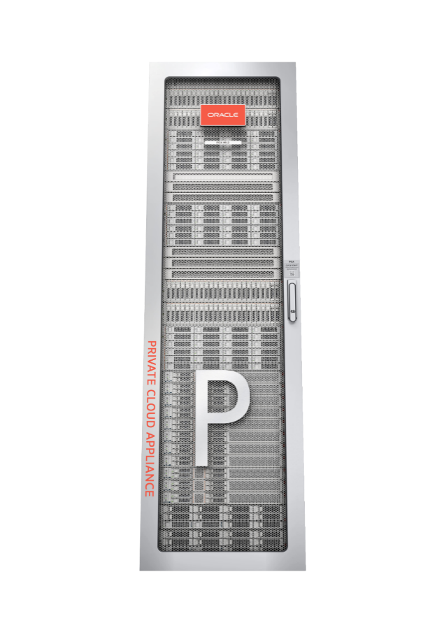
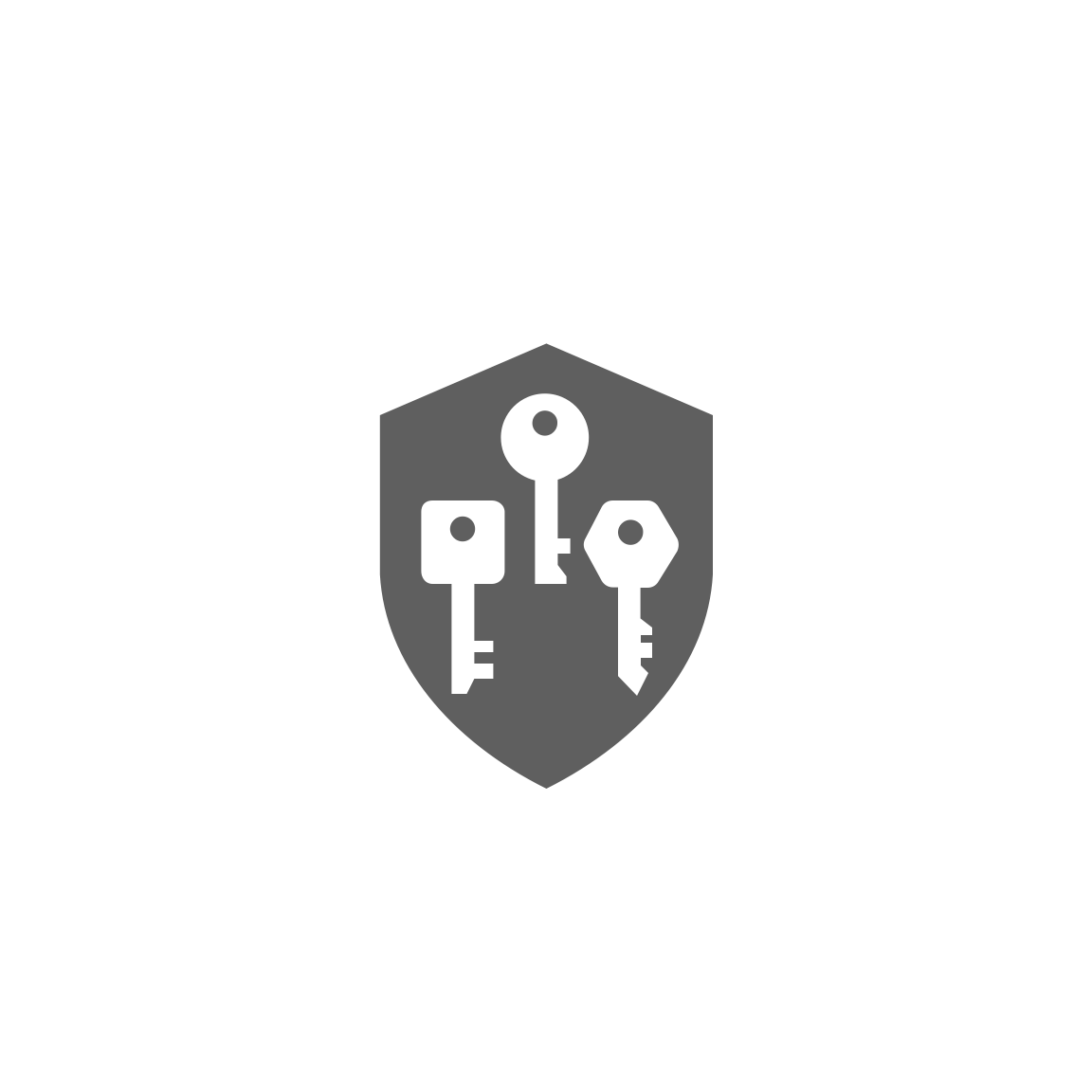
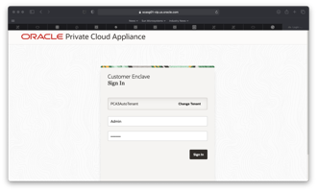




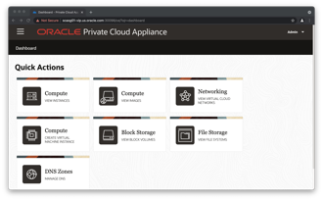


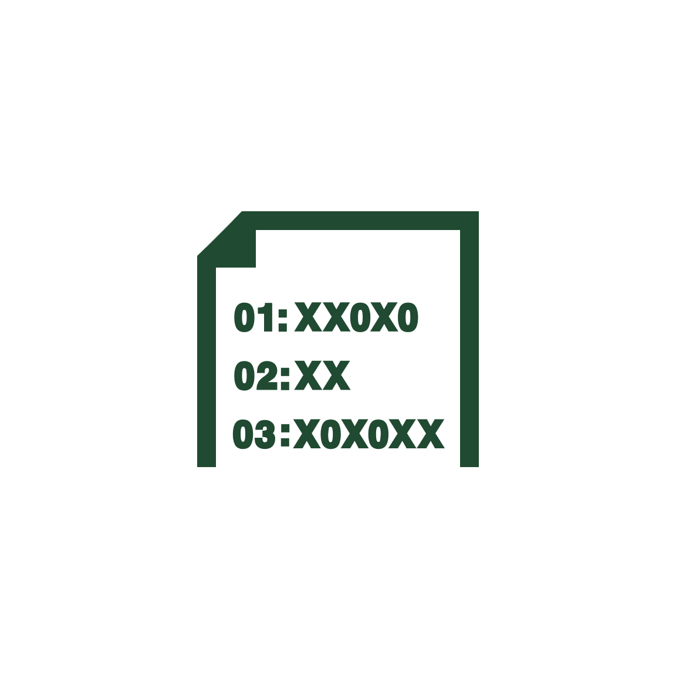


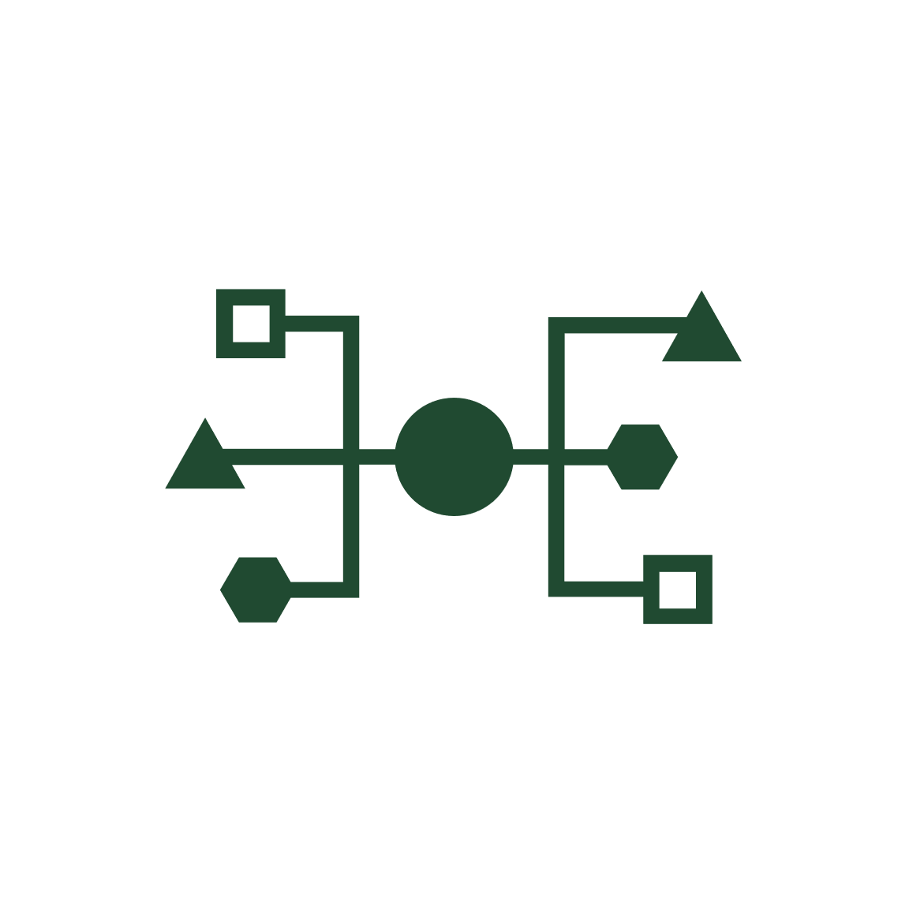
Oracle Cloud Compatible Infrastructure on Premises
Engineered for Mission Critical Private Cloud
Security and Governance
Identity and Access
Policy
Tagging
Encryption
Image portability to OCI
OCI compatible APIs
Tools and Services
CI/CD
SDK
Storage
Block
File
Object
Network
Virtual Cloud Network
Network Services
Security Lists
Gateway Services
Datacenter Connectivity
Business Continuity
Fault Domains
Disaster Recovery
Monitoring and Management
Grafana, Prometheus
Compute
Virtual Machines
6
Copyright © 2023, Oracle and/or its affiliates, All Rights Reserved.
Notes:
The PCA X9 brings OCI Infrastructure concepts and functionality to customer premises.
The software stack on PCA X9 is compatible with OCI Infrastructure APIs. VMs are portable between OCI and PCA X9 with little or no modification. The PCA X9 software is updated using the same Continuous Integration / Continuous Delivery (CI/CD) model that is used in OCI.
Just like in OCI, there are 3 fault domains to which all of the compute nodes in PCA X9 are divided into – these fault domains provide isolation from any potential hardware faults or outages. A DR solution architecture between two separate / remote PCA X9s is available.
Monitoring and management of PCA X9 can be achieved via the included BUI, or via data sent to a Grafana platform.
PCA X9 provides the following capabilities for infrastructure that are like those in OCI –
Compute: VMs
Network: VCN, Sec Lists, Gateway Services, Datacenter connectivity
Storage: Block, File and Object storage
Security / Governance: Identity and Access Management (IAM), Tagging, Encryption

Slide 7
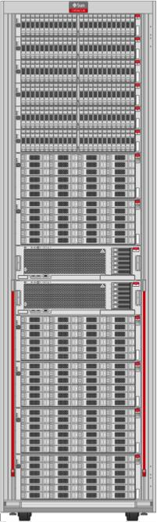
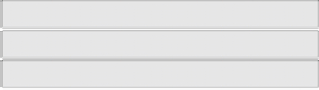

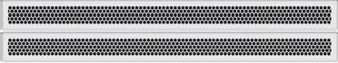
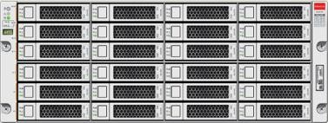
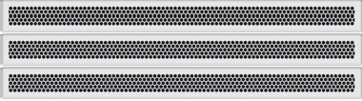
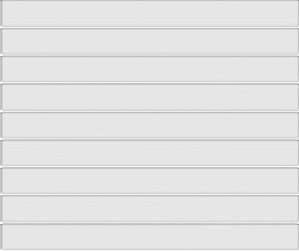
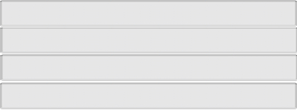
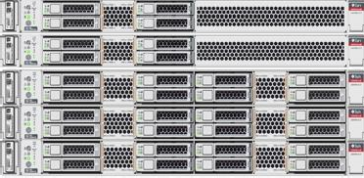
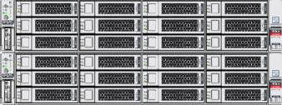
PCA Base Rack
Flex
Flex
Flex Bay 4
Flex Bay 3
Spine Switches
Base Storage DE3-24C
Leaf and Mgmt Switches
Flex Bay 2
Flex Bay 1
Base Rack configuration includes:
• 3x Management Nodes
• 3x Compute Nodes populated in three reserved rack units
• 8x RU pre-cabled for compute
• 2x ZFSSA Controllers
• 1x DE3-24C
• 4x Cisco 9336C 100GbE switches
• 2x Access, 2x Aggregation
• 1x Cisco 9348GC management switch
• Total 19RU
Remaining rack space can accommodate 4 additional flex bays
Flex
Flex
Compute
• Up to 18 compute nodes total
• Up to 2.1 PB raw storage capacity
• Using 18TB HDDs; 1.7 PB with 14TB HDDs
Management Nodes
Storage Controllers
7
Copyright © 2023, Oracle and/or its affiliates | Confidential: Restricted

Slide 8
PCA Base Rack – Flex Bays
Flex
Flex
Flex Bay 4
Flex Bay 3
Spine Switches Base Storage DE3-24C
Leaf and Mgmt Switches
Flex Bay
2
Flex Bay 1
Flex Bays reserved as 4RU areas in the rack that can accommodate various combinations of rack components
• 1 to 4x Compute Nodes
• 1 to 2x DE3-24P drive enclosures
• 1x DE3-24C drive enclosure
Once a bay type is selected, the 4RU area is set for that purpose
• Compute Node bay will accommodate only compute nodes
• Additional compute nodes added until 4RU bay is completely populated
• DE3-24P bay accommodates only DE3-24P
• 2nd enclosure added to fully populate bay before adding additional DE3-24P bays. Otherwise, 2RU populated with solid filler panels
Flex
Flex
Compute
Management Nodes
Storage Controllers
8
Copyright © 2023, Oracle and/or its affiliates | Confidential: Restricted

Slide 9
PCA Base Rack – Flex Bays
Flex
Flex
Flex Bay 4
Flex Bay 3
Spine Switches Base Storage DE3-24C
Leaf and Mgmt Switches
Flex Bay
2
Flex Bay 1
Flex Bays reserved as 4RU areas in the rack that can accommodate various combinations of rack components
• 1 to 4x Compute Nodes
• 1 to 2x DE3-24P drive enclosures
• 1x DE3-24C drive enclosure
Once a bay type is selected, the 4RU area is set for that purpose
• Compute Node bay will accommodate only compute nodes
• Additional compute nodes added until 4RU bay is completely populated
• DE3-24P bay accommodates only DE3-24P
• 2nd enclosure added to fully populate bay before adding additional DE3-24P bays. Otherwise, 2RU populated with solid filler panels
Flex
Flex
Compute
Management Nodes
Storage Controllers
9
Copyright © 2023, Oracle and/or its affiliates | Confidential: Restricted

Slide 10
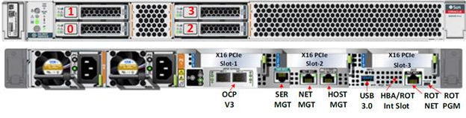

PCA X9 Management Node Configuration
3.84TB
NVMe SSD
CX5 2x100GbE
2x Ice Lake 24C/2.0GHz/165W
1TB, 16x 64GB DDR4-3200
2x M.2 SATA 240GB
CPU:
DRAM:
Boot:
Storage: 2x NVMe 3.84TB
IO:
Mgmt:
CX5 2x100Gb Ethernet OCP v3 module
NET0 + Sideband
10
Copyright © 2023, Oracle and/or its affiliates | Confidential: Internal/Restricted

Slide 11

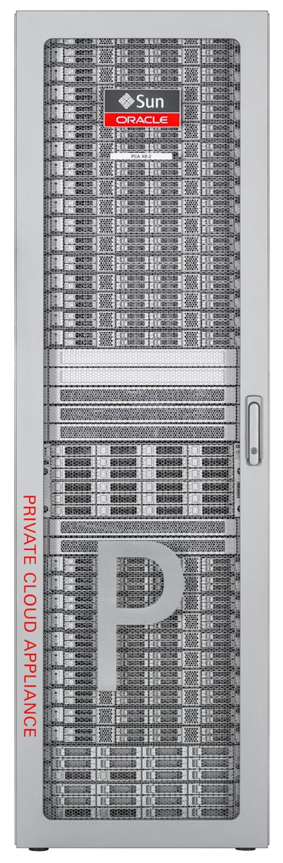


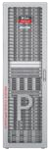
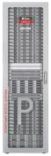
System Network Interfaces
Customer Interface
• Application
Client/User
Data load
Local Archive
Intra-region Interface
Backup, Disaster Recovery
AD – AD service communication
Availability Domain scaling
Scaling AD compute/storage/services with
additional infrastructure racks
Exadata/Exa-CC connectivity
Oracle Cloud Interface
Service delivery
Management, monitoring, maintenance
Customer Network & CPE
Customer
Intra-region
AD Scaling
Oracle Cloud
37 Confidential – Oracle Highly Restricted

Slide 12

System Architecture
PCA X9
Copyright © 2023

Slide 13
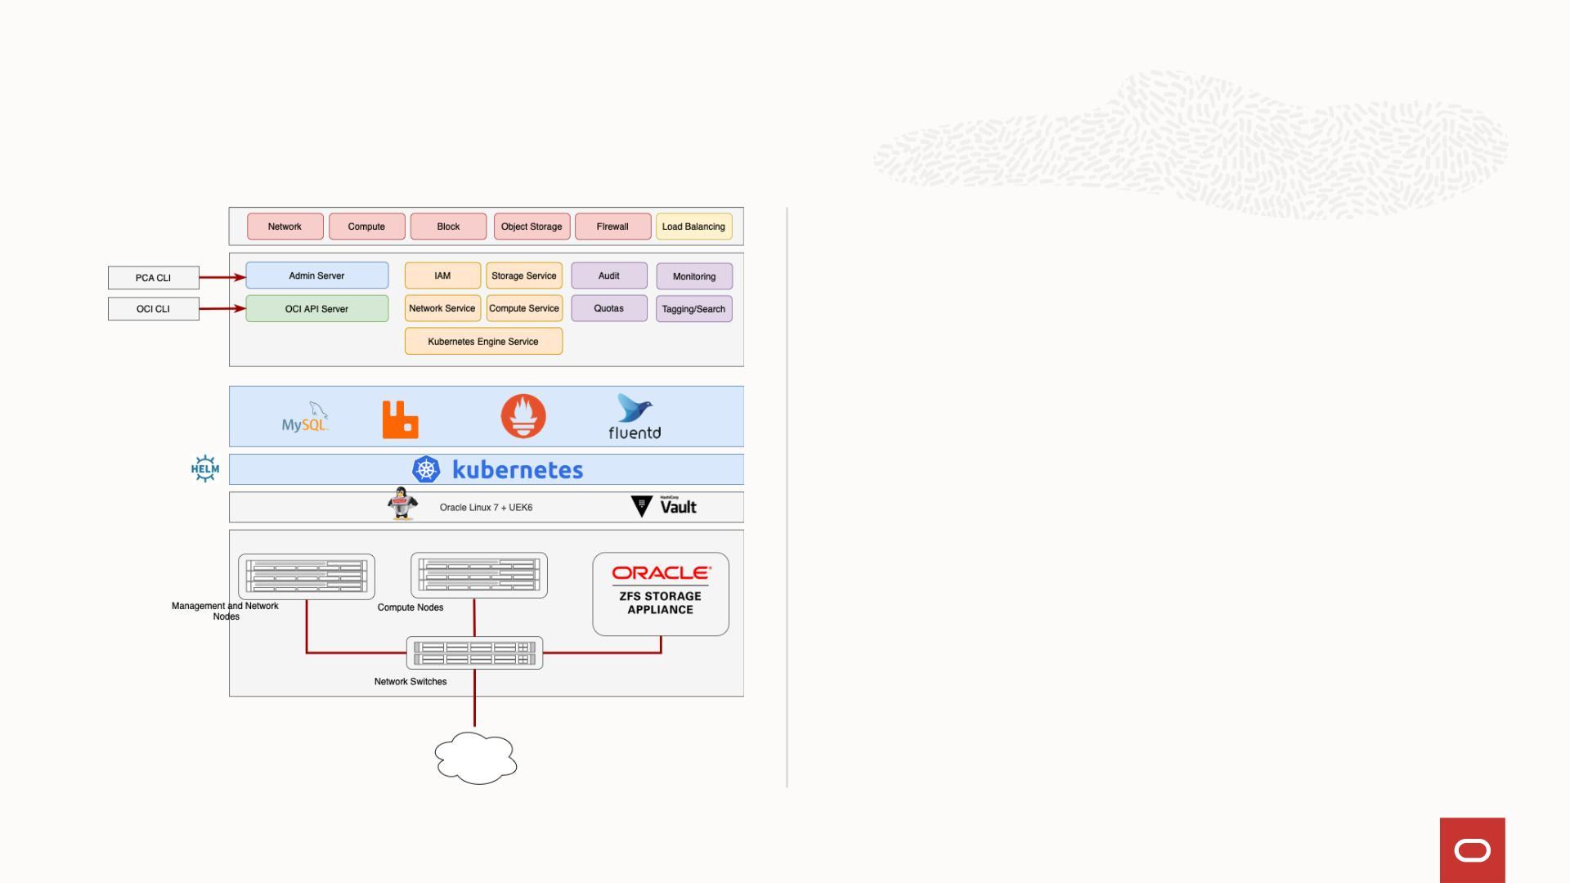
Software Architecture
Microservices-based architecture
• Maximizes Availability
• Enables non-disruptive upgrade
• Hardware independent
Copyright © 2023

Slide 14
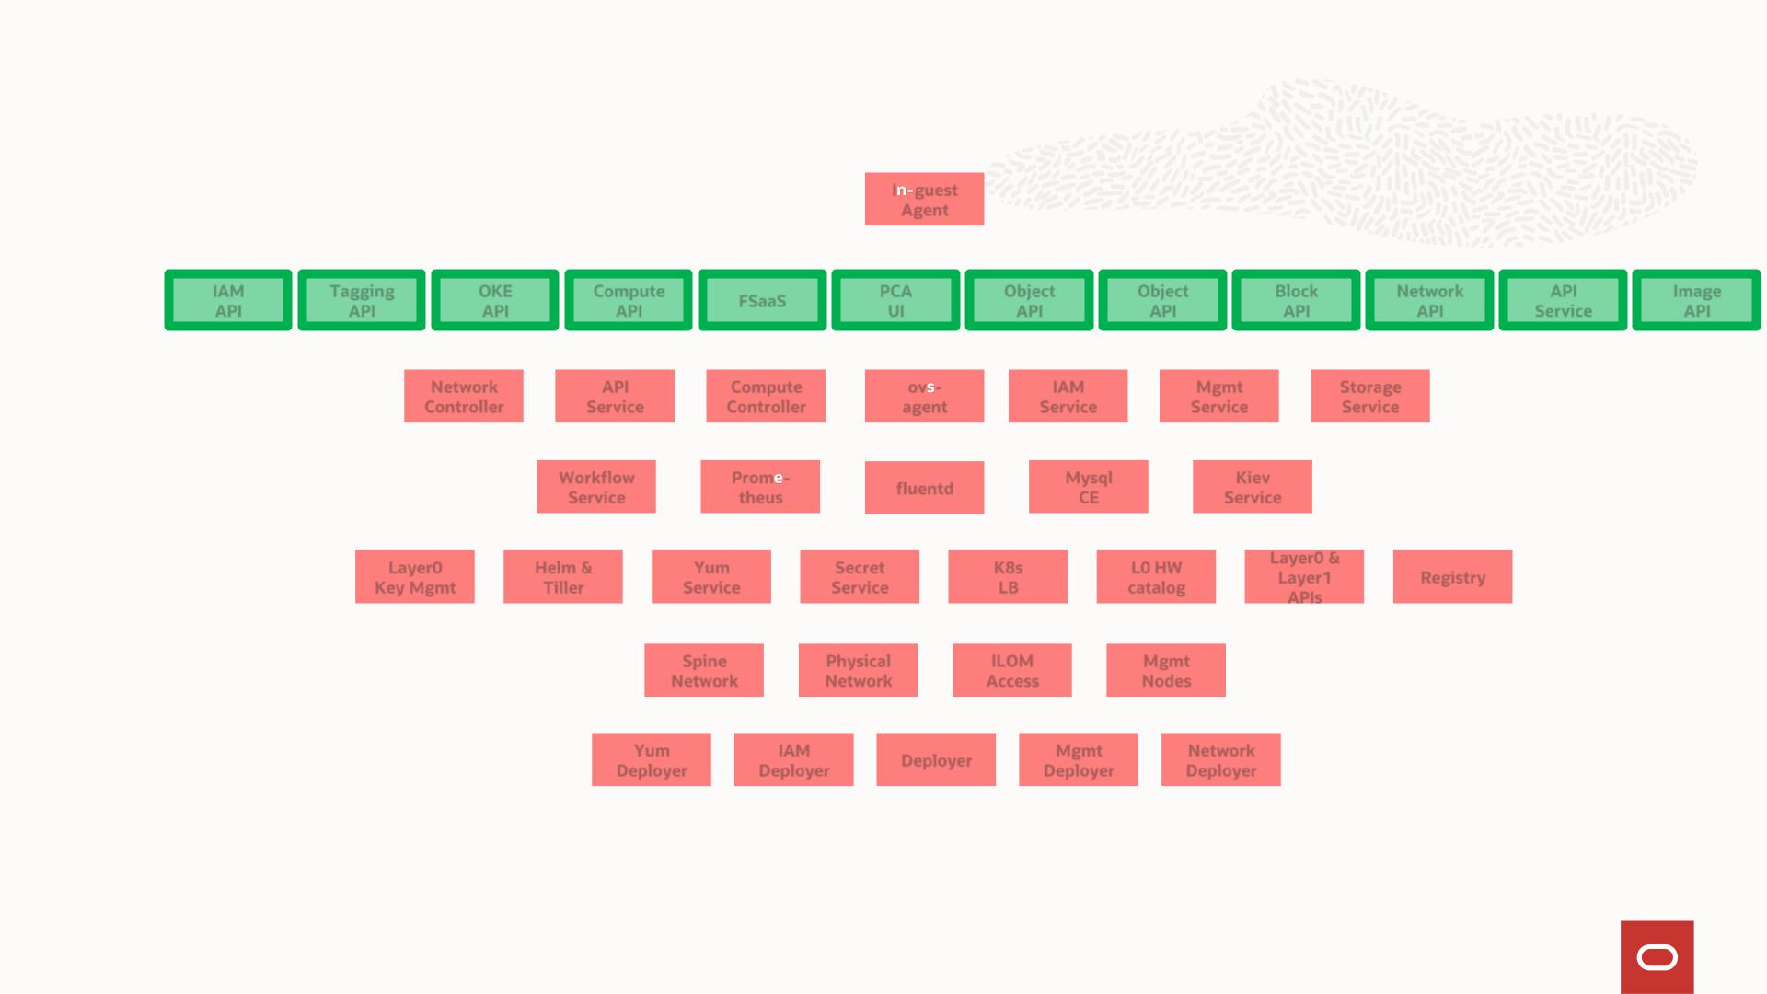
Software Architecture
Customer
I
guest
Agent
Instance
API
IAM
API
Tagging
API
OKE
API
Compute
API
FSaaS
PCA
UI
Object
API
Object
API
Block
API
Network
API
API
Service
Image
API
Controllers
Network
Controller
API
Service
Compute
Controller
ov -
agent
IAM
Service
Mgmt
Service
Storage
Service
Common
Services
Workflow
Service
Prom -
theus
Mysql
CE
Kiev
Service
fluentd
Layer 0/1
Layer0
Key Mgmt
Helm &
Tiller
Yum
Service
Secret
Service
K8s
LB
L0 HW
catalog
Layer0 &
Layer1
APIs
Registry
Physical
Spine
Network
Physical
Network
ILOM
Access
Mgmt
Nodes
Deployer
Yum
Deployer
IAM
Deployer
Deployer
Mgmt
Deployer
Network
Deployer
Copyright © 2023

Slide 15
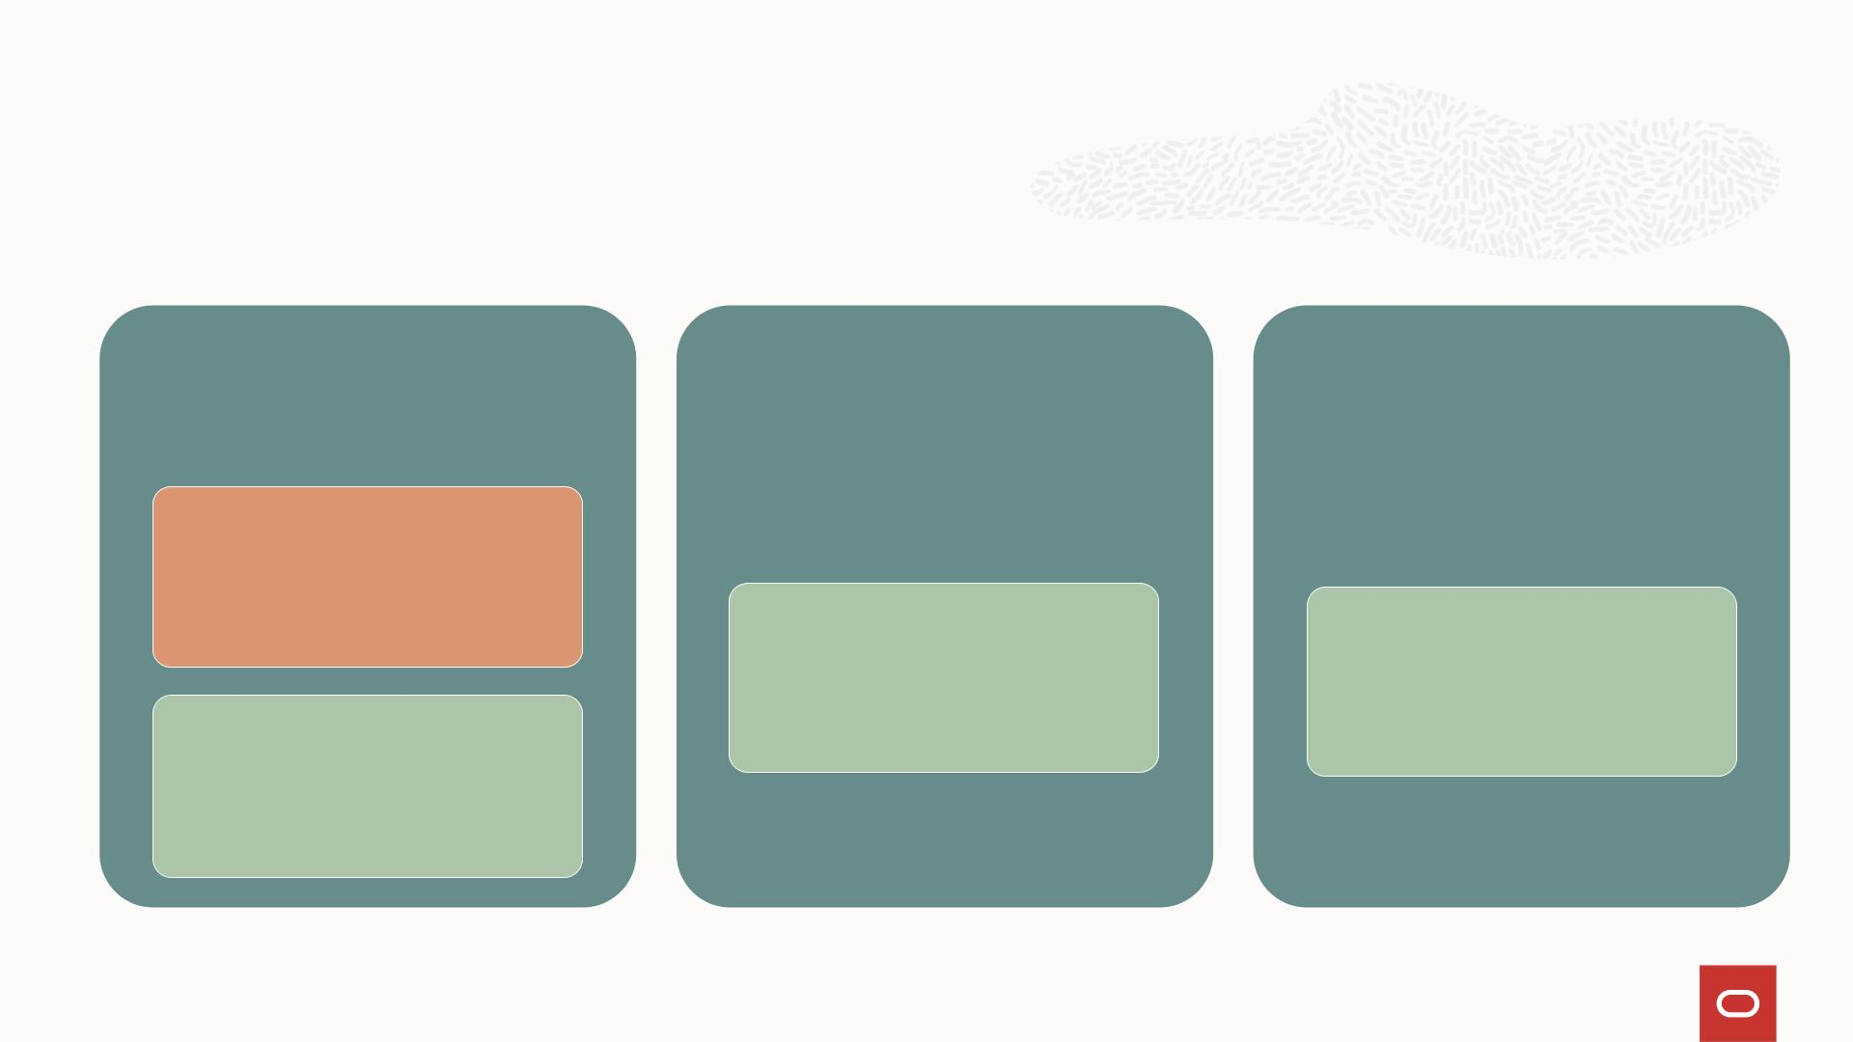
Platform Strategy – Kubernetes Cluster
Management Node Management Node Management Node
Master
Worker
Worker
Worker
9
Copyright © 2023

Slide 16
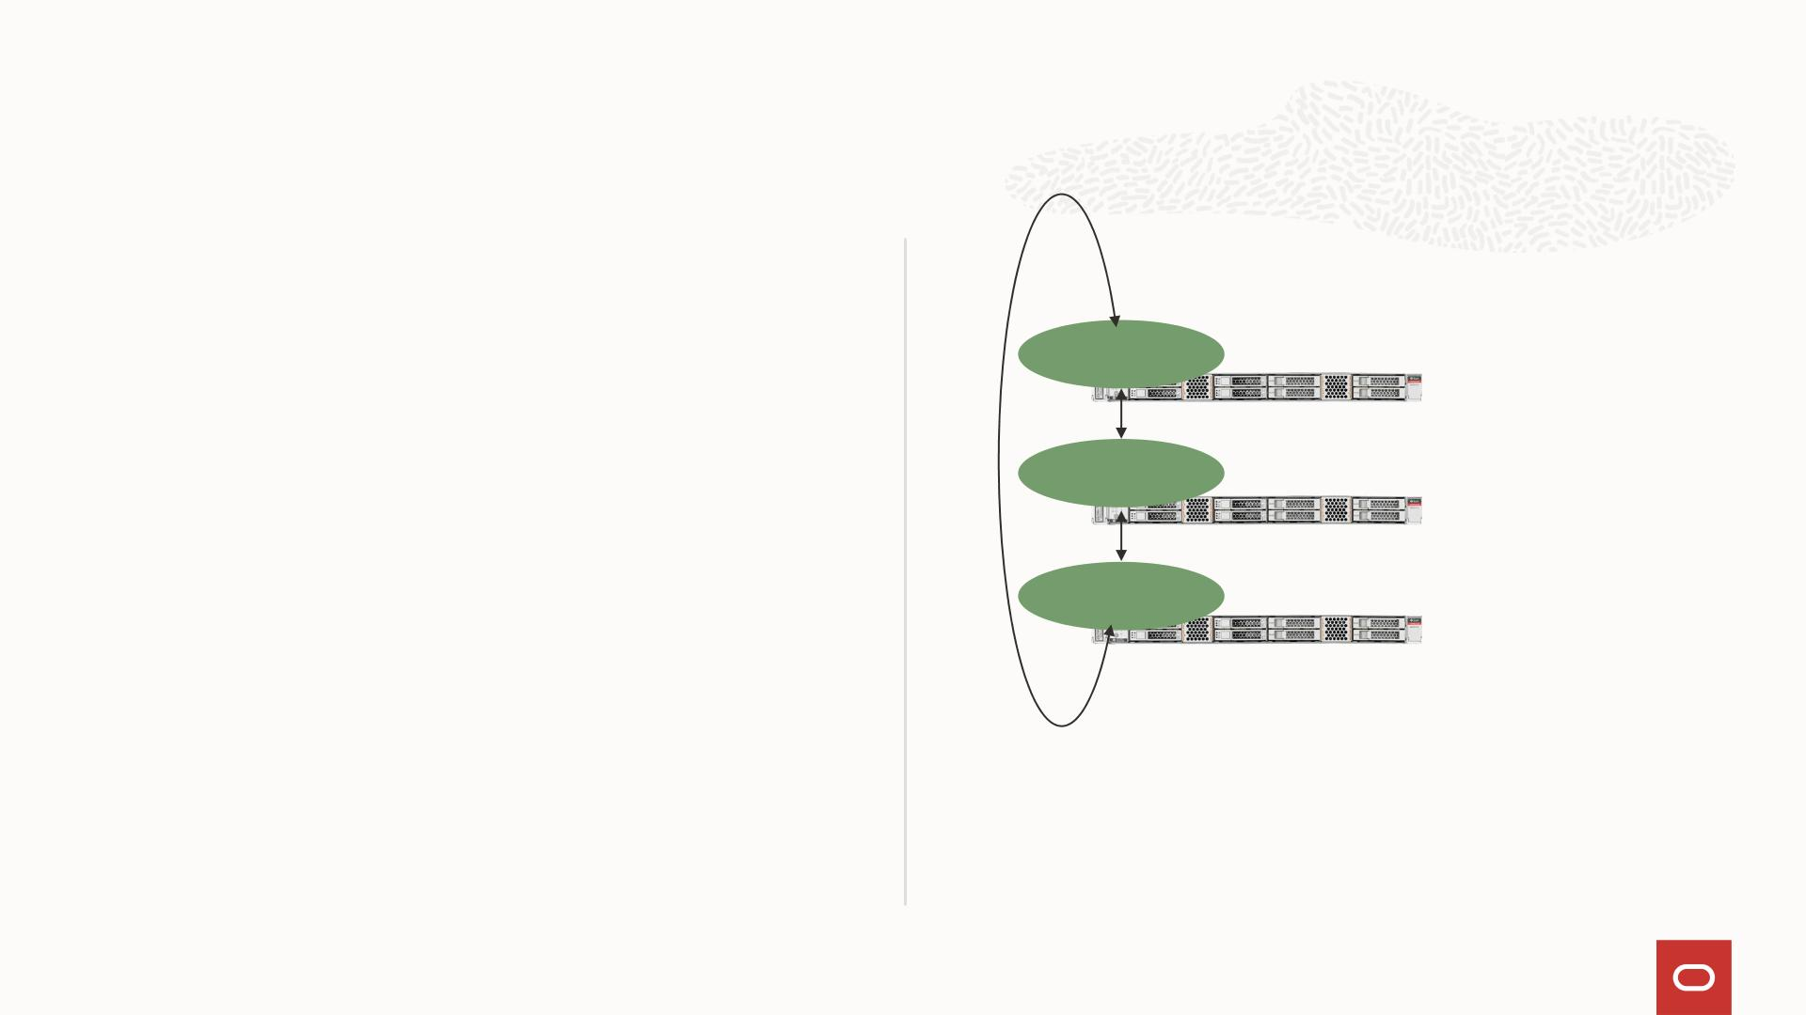
PCA Microservices
• Packaged within a Docker container that is
managed & deployed via Kubernetes
• HA is attained by running one container on
Service
Instance #1
each of three Management Nodes
Management
Node 1
• RabbitMQ is used to communicate with other
microservices within the PCA system
Service
Instance #2
• Loki used for log aggregation
Management
Node 2
• Prometheus used for statistics collection
Service
Instance #3
Management
Node 3
10
Copyright © 2023, Oracle Internal

Slide 17

Upgrades - System Platform Services
• Upgrades to micro-services done by deploying
newer version to the registry
• Kubernetes determines when and how to
replace older apps
• Rollback built into Kubernetes
PAAS
OCI API
• OS, kernel, and PCA L1 stack updated with yum
• Yum repo managed by pca-upgrader
• Firmware upgrades can be synchronized with
OS upgrades to minimize reboots
Kubernetes Management
Hardware Management
• Firmware HMP and OS modules can always be
on the same version
• Unified utility simplifies patching for Platinum
and PCC
11
Copyright © 2023

Slide 18
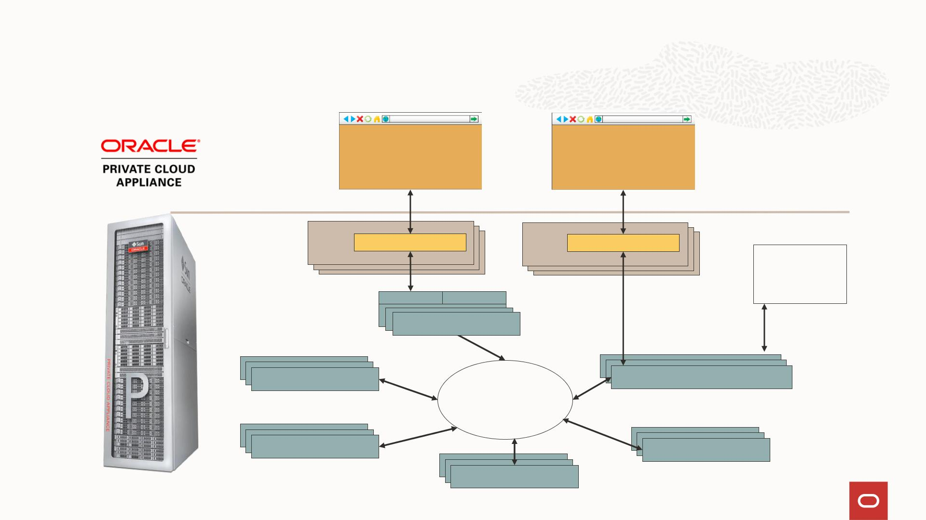
User Interfaces and Service Communication
Service Enclave
Customer Enclave
JET UI
JET UI
Apache
Tomcat
Java Thin Layer
Apache
Tomcat
Java Thin Layer
OCI CLI
Binaries
WSAPI
CLI
Admin Service
IAM Service
API Service
RabbitMQ
Network Service
Storage Service
Compute Service
Copyright © 2023

Slide 19
Infrastructure Services
Services supported at release
Copyright © 2023

Slide 20
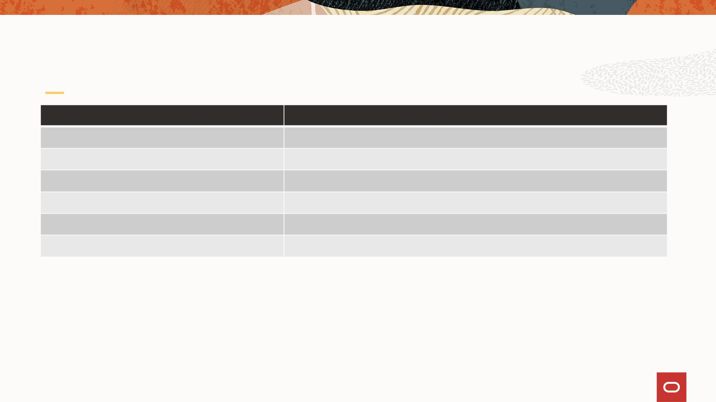
OCI IaaS – Initial Release
OCI Service
Identity and Access Management
Compute
Features
SAML 2.0 Federation
Fixed Virtual Machine Shapes (X9)
Subnets, vnics, gateways, routing tables, security lists, …
Balanced and Performance
OCI
VCN
Block Storage
Object Storage
File Storage
NFS, SMB
Copyright © 2023

Slide 21
Infrastructure Services
IAM
Copyright © 2023

Slide 22

IAM
Identity and access management features such as authentication, single sign-on (SSO), and
identity lifecycle management
IAM Components
RESOURCE
•
The cloud objects that your company's employees create and use when interacting with Oracle Cloud Infrastructure (for example,
compute instances, block instances, block storage volumes, virtual cloud networks, subnets, etc.), third-party applications, Software-as-
a-Service (SaaS) applications, on-premises software, and retail web applications.
USER
•
An individual employee or system that needs to manage or use your company's Oracle Cloud Infrastructure resources. Users might need
to launch instances, manage remote disks, work with your virtual cloud network, etc. End users of your application are not typically IAM
users. Users have one or more IAM credentials (see User Credentials).
IAM
GROUP
•
A collection of users who all need the same type of access to a particular set of resources or compartment.
NETWORK SOURCE
A group of IP addresses that are allowed to access resources in your tenancy.
COMPARTMENT
A collection of related resources. Compartments are a fundamental component of Oracle Cloud Infrastructure for organizing and
•
User
Groups
Policies
•
isolating your cloud resources. You use them to clearly separate resources for the purposes of measuring usage and billing, access
(through the use of policies), and isolation (separating the resources for one project or business unit from another). A common approach
is to create a compartment for each major part of your organization.
TENANCY
Compartments
•
The root compartment that contains all of your organization's Oracle Cloud Infrastructure resources.
POLICY
•
A document that specifies who can access which resources, and how. You can write policies to control access to all of the services within
Oracle Cloud Infrastructure. Access is granted at the group and compartment level, which means you can write a policy that gives a
group a specific type of access within a specific compartment, or to the tenancy itself. If you give a group access to the tenancy, the
group automatically gets the same type of access to all the compartments inside the tenancy.
Oracle Cloud
Identifier
Tagging
FEDERATION
•
A relationship that an administrator configures between an identity provider and a service provider.
Copyright © 2023

Slide 23

IAM Service: Overview
• Supports two main OCI features
• Policies
• Tagging
• Authenticates and uses policies to authorize all incoming requests
• Supports other OCI objects and operations
• Users
• UserGroups, UserGroupMemberships
• Compartments
• ApiKeys
• Supports federation with IdPs supporting SAML 2.0
• Active Directory federation
20
Copyright © 2023, Oracle Internal

Slide 24
Infrastructure Services
Compute
Copyright © 2023

Slide 25

Compute
Virtual Machine
• A virtual machine (VM) is an independent
computing environment that runs on top of
physical bare metal hardware. The virtualization
makes it possible to run multiple VMs that are
isolated from each other. VMs are ideal for running
applications that do not require the performance
and resources (CPU, memory, network bandwidth,
storage) of an entire physical machine.
Virtual Machine
Copyright © 2023

Slide 26
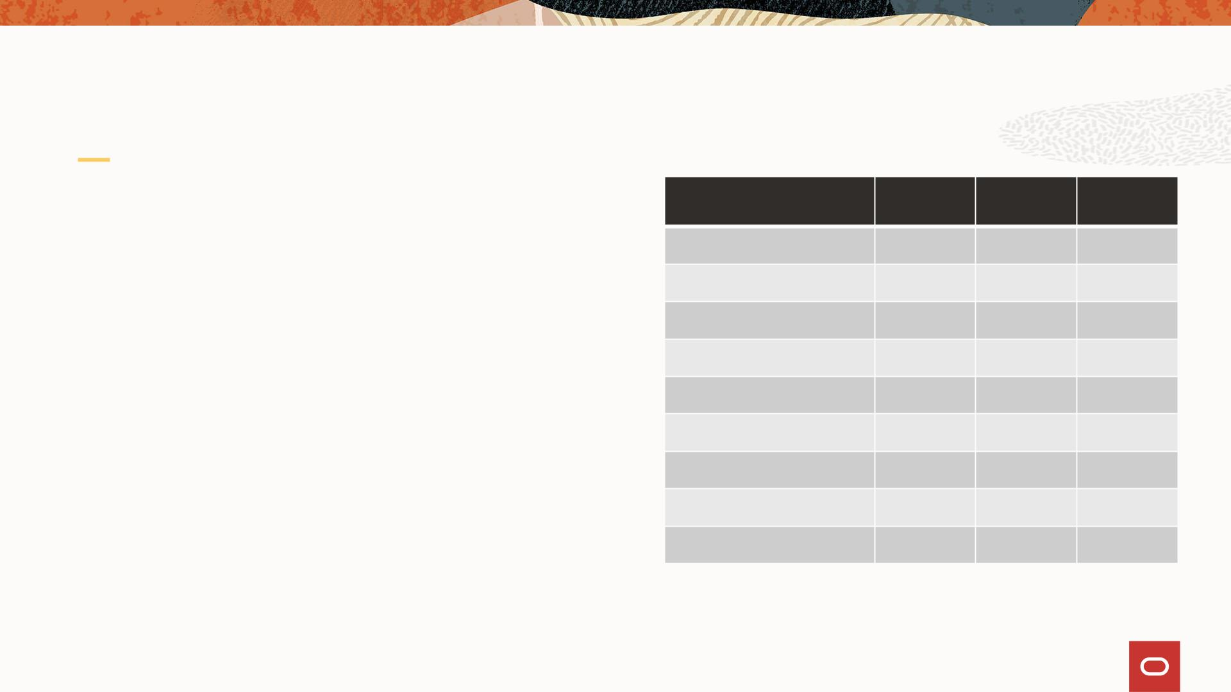
Compute - Supported VM Shapes
Shape
OCPUs
Memory
(GB)
OCI
Portable
VM Shapes
• Fixed 1:16 ratio (OCPU:GB Memory)
VM.PCAStandard1.1
VM.PCAStandard1.2
VM.PCAStandard1.4
VM.PCAStandard1.8
VM.PCAStandard1.16
VM.PCAStandard1.24
VM.PCAStandard1.32
VM.PCAStandard1.48
VM.PCAStandard1.Max
1
2
4
8
16
✓
✓
✓
✓
✓
✕
✕
✕
✕
32
64
Resources reserved for the hypervisor
128
256
384
512
768
960
• 4 cores
• 40 GB memory
16
24
32
48
60
OCI Portability
• OCI supports shapes up to 18 OCPUs on X9
(VM.Optimized3.Flex)
Copyright © 2023

Slide 27
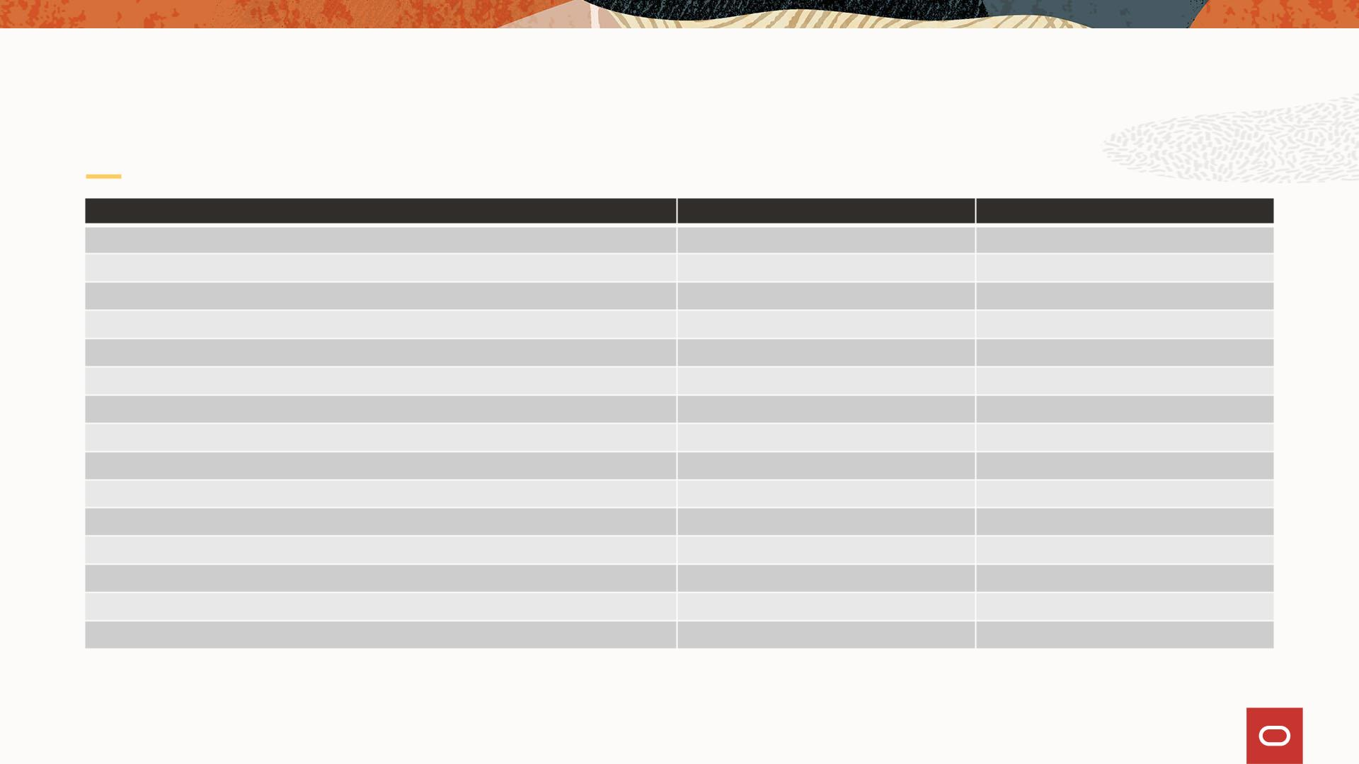
PCA X9 – Guest OS Matrix
Guest Operating System
Oracle Linux Release 8.x
Platform Image
Custom Image
✓
✓
✓
✓
✓
✓
✓
✓
✓
✓
✓
✓
✓
✓
✓
✓
✓
Oracle Linux Release 7.x
Red Hat Enterprise Linux 8.x
Red Hat Enterprise Linux 7.x
CentOS 8.x
CentOS 7.x
SUSE Linux Enterprise Server 12 SP5
SUSE Linux Enterprise Server 15 SP1
Ubuntu 20.04 and later
Ubuntu 18.04 and later
Oracle Solaris 11
Microsoft Windows Server 2019
Microsoft Windows Server 2016
Microsoft Windows Server 2012 R2
Microsoft Windows Server 2012

Slide 28
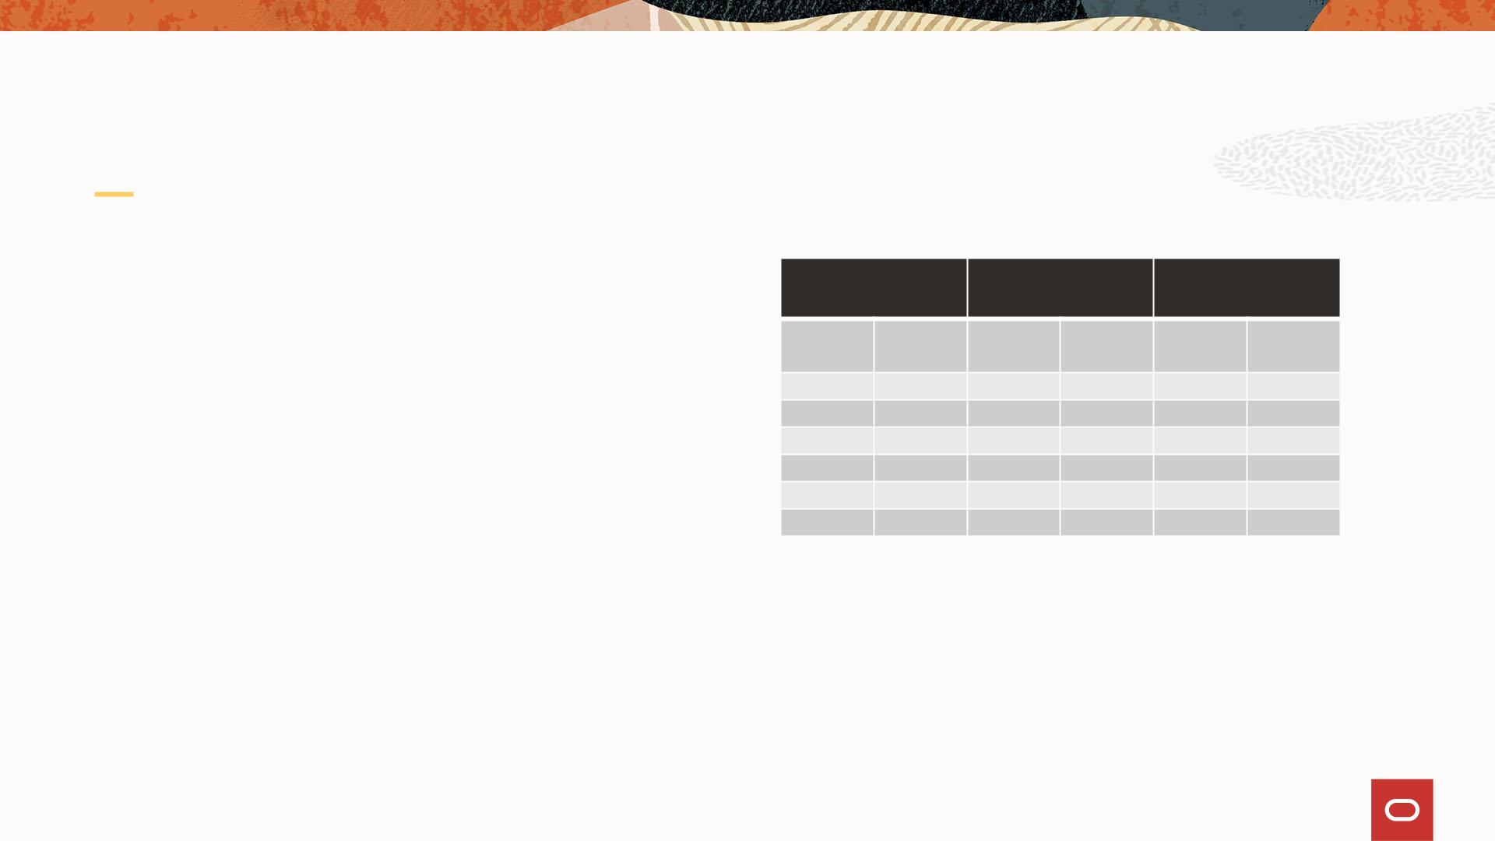
Compute - Recommended System Sizing to Support Zero Down
Time Upgrade
1. Calculate required system OCPU
capacity leveraging supported VM
System Size
Reserve
Capacity
Available
Capacity
shapes
2. Select system size which provides
“Available Capacity” greater than
required OCPU capacity
3. When using large VM shapes (OCPU
16 or greater), increase ”reserve
capacity” to ensure that large VMs
can be moved during upgrade.
4. When configuring the system set
alerts to ensure that desired “reserve
capacity” is available
Compute
Nodes
OCPUs
%
OCPUs
%
OCPUs
3
6
9
180
360
540
33%
17%
11%
8%
60
60
60
60
60
60
67%
83%
89%
92%
93%
94%
120
300
480
12 720
15 900
18 1,080
660
840
1,020
7%
6%
Note: Reserve Capacity is simply 20 cores
per fault domain.
Copyright © 2023

Slide 29
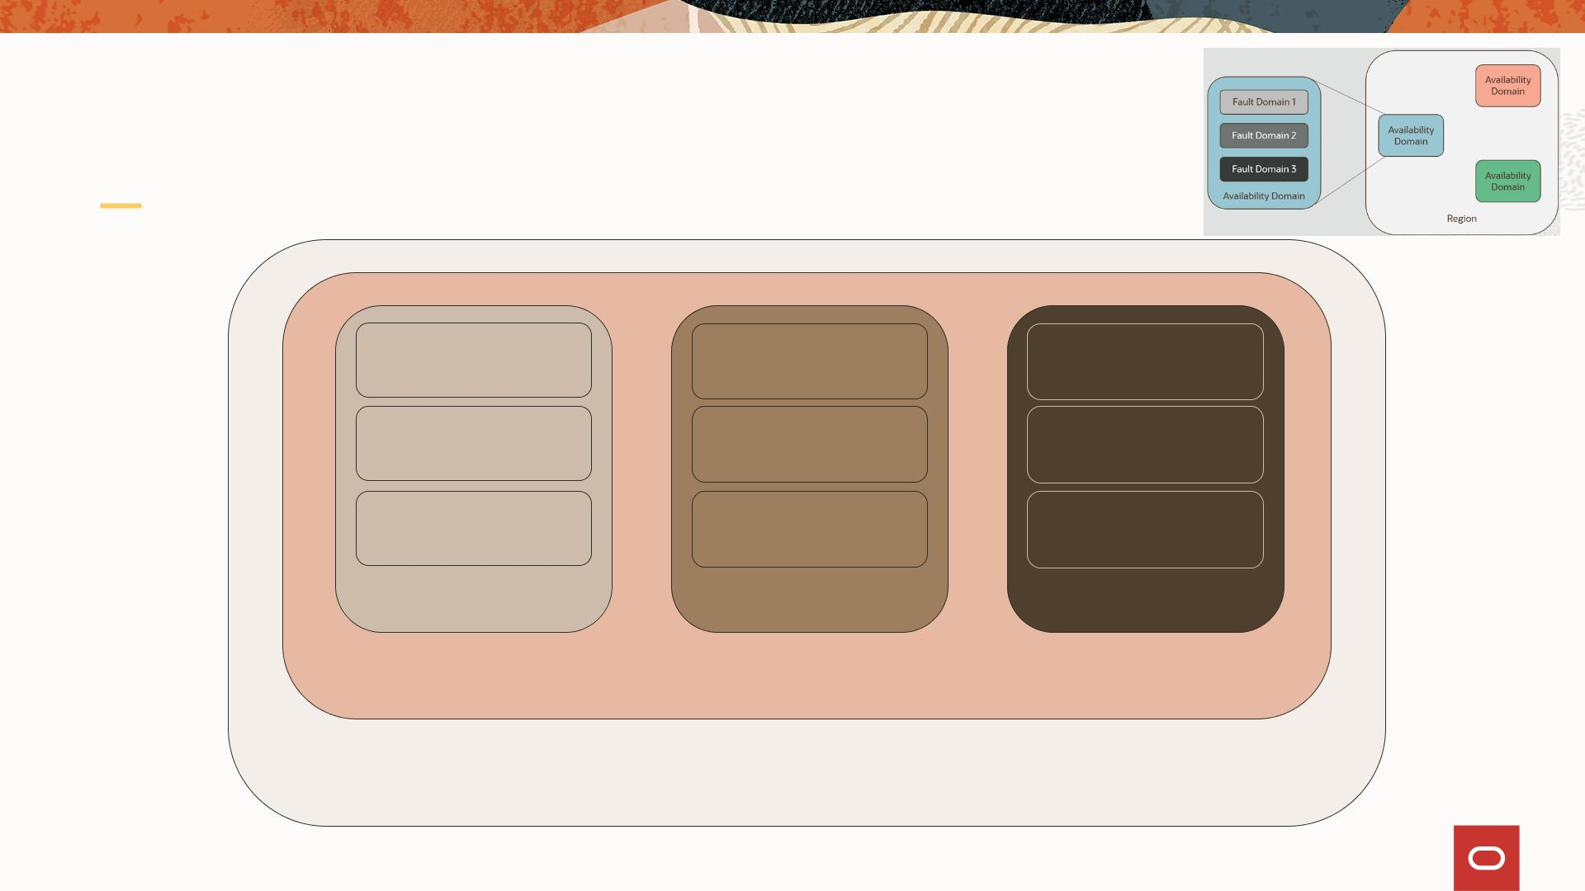
PCA X9 Architecture In Practice
pcacn001
pcacn004
pcacn002
pcacn003
pcacn006
pcacn005
pcacn007
pcacn008
pcacn009
FAULT-DOMAIN-1
FAULT-DOMAIN-2
FAULT-DOMAIN-3
AD1
mypca01
Copyright © 2023

Slide 30
Infrastructure Services
Containers – Cloud Native
Copyright © 2023

Slide 31
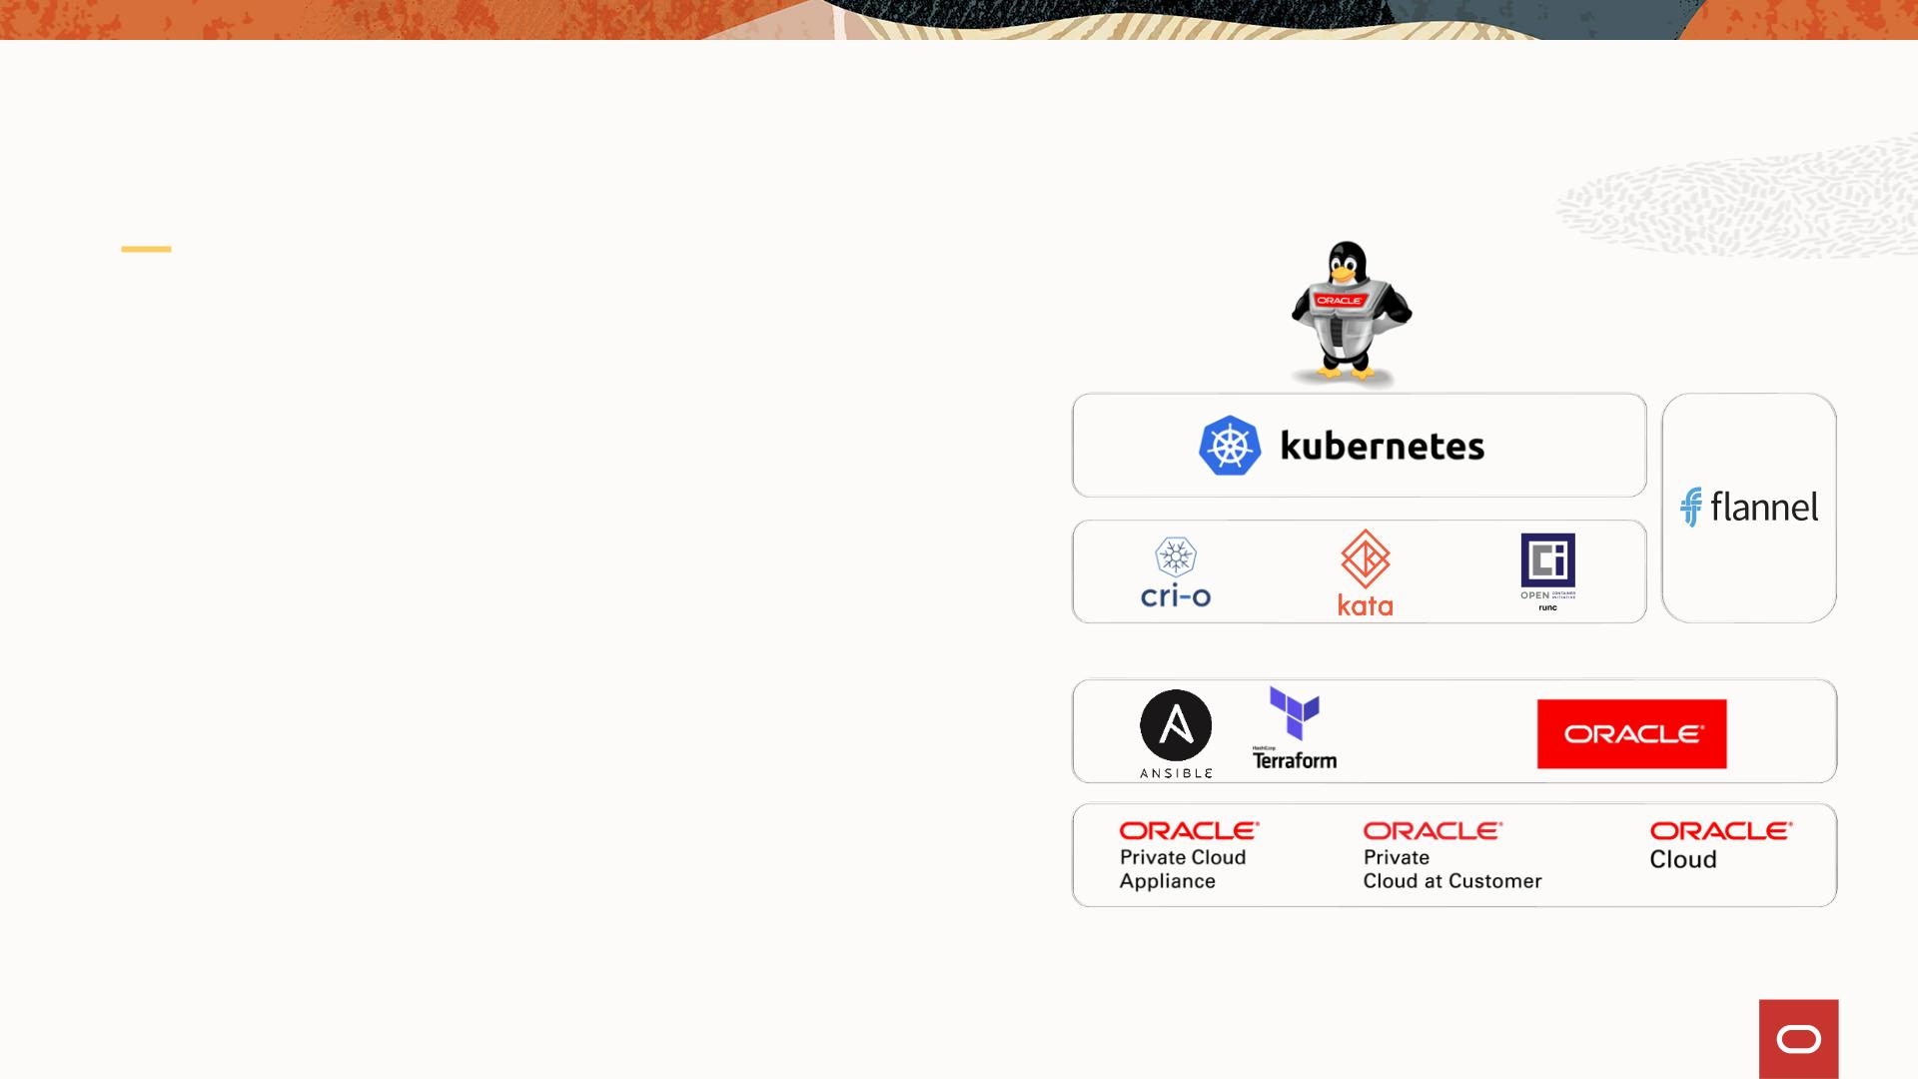
Cloud Native Environment for Private Cloud
• Oracle Linux Cloud Native
Environment included
• An open, integrated operating
Cloud Native
Networking
environment that is popular with
developers and easy for IT
operations to deliver:
Orchestration &
Management
• Containers and orchestration
• Management tools
Runtime
Automation and Configuration
Container Registry
• Development tools
• Supports the open standards,
specifications, and APIs defined by
the Cloud Native Computing
Foundation (CNCF)
Provisioning
Infrastructure
Copyright © 2023

Slide 32

Oracle Products currently supported inside Docker containers
Available on Oracle Container Registry
• Oracle Linux
• Oracle Business Intelligence
• Oracle Coherence
• Oracle Fusion Middleware Infrastructure
• Oracle Data Integrator
• Oracle SOA Suite
6 and 7 with slim variants
• MySQL Community Server
• MySQL Server Enterprise Edition
• Oracle Java SE
• Oracle NoSQL Database
• Oracle Database
• Oracle Tuxedo
• Oracle WebLogic Server
• Oracle HTTP Server
……more
• Oracle GoldenGate
Copyright © 2023

Slide 33
Infrastructure Services
Storage
Copyright © 2023

Slide 34
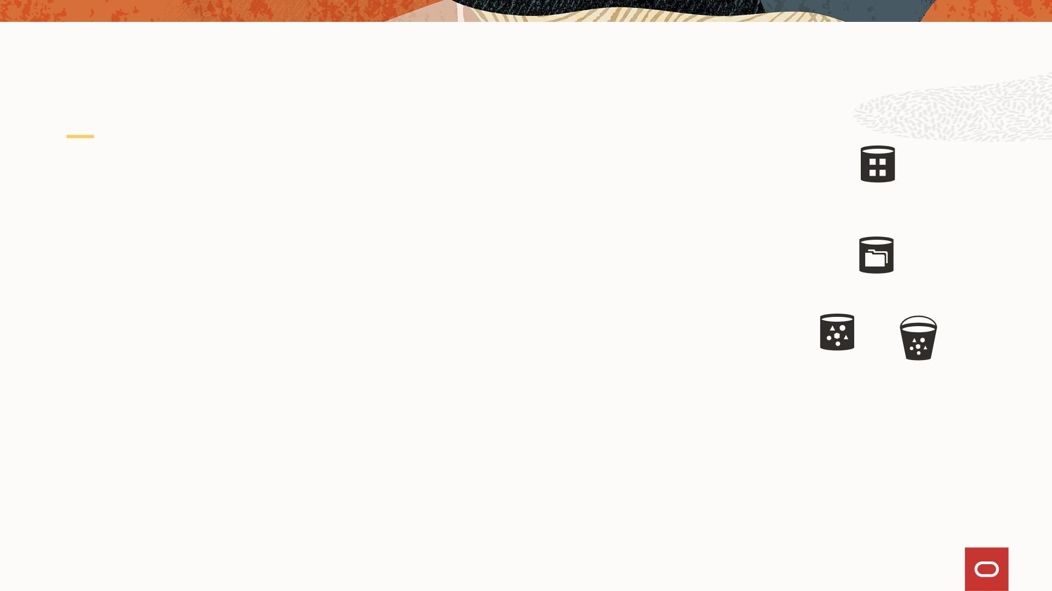
Storage Overview
Support for fundamental storage services
• Block
Block
Storage
• Performance tiers dependent upon disk enclosure
hardware
• “Balanced” and “Performance”
File Storage
• File
• NFS (v3/v4)
• SMB
Object
Storage
Buckets
• Note - file is “very expensive” in public clouds
• Object
• OCI object store
Copyright © 2023

Slide 35

Storage
Base storage
Min
Max
• Base includes a single high-capacity tray
• 140 TB user storage
High Capacity Tray
1
48
High Performance Tray
(optional)
0
47
• 40 TB reserved capacity (system use)
High Capacity Storage
• Storage services supported: balanced block, file,
object
High Performance Storage (optional)
• Storage services supported: performance block
Sizing Considerations
• Include the following in sizing calculations: data
storage, user storage, VM images, backups,
snapshots, clones, …
Copyright © 2023

Slide 36
Infrastructure Services
Networking
Copyright © 2023

Slide 37
PCA-X9 Networking – Core Components
PCA-X9 Networking functionality consists of the following Kubernetes (K8s) controllers and
Management services:
• A Network Controller (NC/nwctrl)
• A Load Balancing Controller (LBC/lbctrl)
• Ethernet Switches - underlay network
• OVN/OVS - Overlay network
• DNS, and Switch Manager micro-service modules
• PCA management nodes
• A ZFSSA.
• MySql Data Base (DB)
Functionality provided by PCA-X9 networking include:
• Supporting the OCI networking CLI/APIs
• Conforming with OCI networking model:
• OCI VCN, subnet, VNIC constructs,
• Private and public IP address,
• Private and public subnets, and
• Various L3 services
• Providing DHCP, firewall, DNS, and Load Balancing networking services,
• Supporting management and storage network traffic.
• Creating MySQL DB objects for OCI objects (VCN, Subnet etc) and any related PCA specific objects.
Copyright © 2023

Slide 38
Networking language of the Cloud (OCI)
Overview
Copyright © 2023

Slide 39
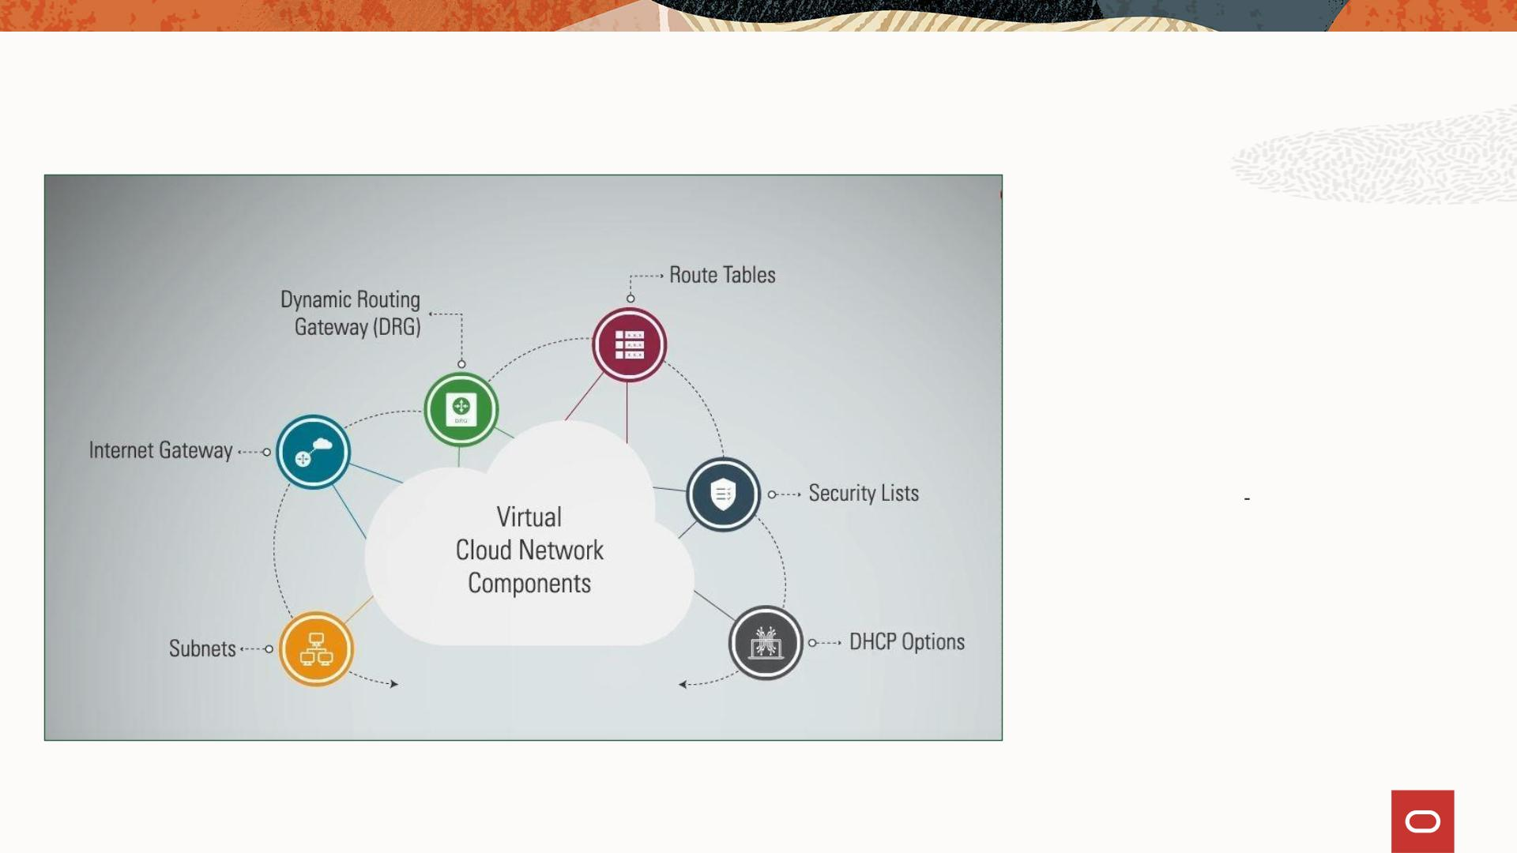
Virtual Cloud Network (VCN)
• Virtual Cloud Network is a software-
defined version of a traditional
physical network including subnets,
route tables, gateways, and firewall
rules. Essentially a “Virtual Data
Centre”.
• VCN covers a single, contiguous
IPv4 CIDR block of your choice
•
Oracle recommends using one of
the private IP address ranges
in RFC 1918 (10.0.0.0/8,
172.16/12, and 192.168/16) for
VCN address space. However, you
can also use a publicly routable
range
• Allowable VCN size range is from
/16 to /30 (VCN reserves the first
two IP addresses and the last one in
each subnet's CIDR)
Copyright © 2023

Slide 40
Securing your VCN
• Public vs Private Subnets - designate a subnet to be private, which means instances in
the subnet cannot have public IP addresses
• Security Lists - To control packet-level traffic in/out of an instance by defining security
rules in your VCN
• Firewall Rules - configure firewall rules directly on the instance itself to control packet-
level traffic in/out of an instance
• Gateways and Route Tables - Control general traffic flow from your cloud network to
outside destinations (the internet, your on-premises network, or another VCN)
• IAM Policies - control who has access to the PCA-X9 customer tenancies or console

Slide 41
VCN Definitions
• Subnets can have one Route Table and multiple Security Lists associated to it
• Route table defines what can be routed out of VCN
• Private subnets are recommended to have individual route tables to control the flow of
traffic outside of VCN
• All hosts within a VCN can route to all other hosts in a VCN (no local route rule required)
• Security Lists manage connectivity north-south (incoming/outgoing VCN traffic) and east-
west (internal VCN traffic between multiple subnets)
• PCA-X9 follows a white-list model (i.e. you must manually specify whitelisted traffic flows).
By default, things are locked down
• Instances cannot communicate with other instances in the same subnet, until you permit
them to!
• Oracle recommends using NSGs instead of SLs because NSGs let you separate the VCN's
subnet architecture from your application security requirements

Slide 42
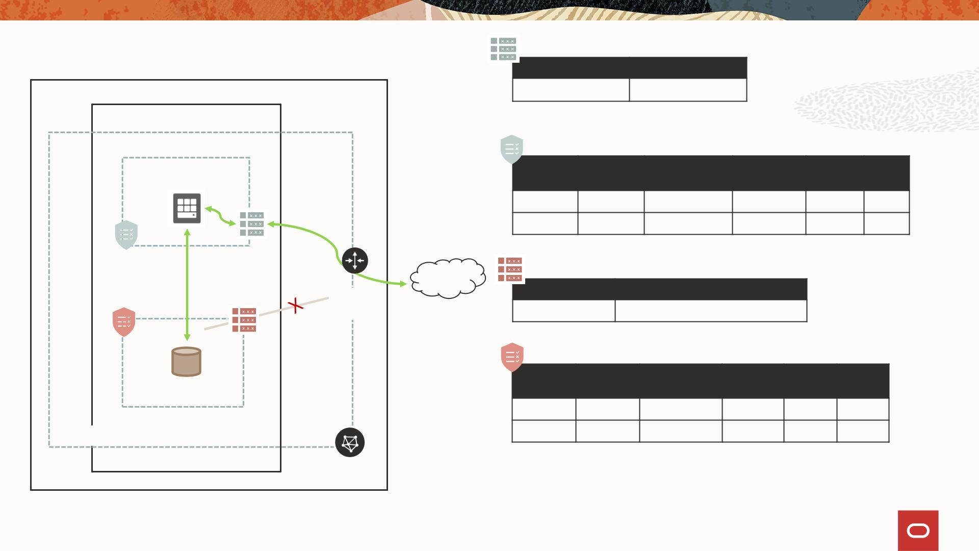
VCN Deployment Architecture
Destination CIDR
0.0.0.0/0
Route Target
ORACLE PRIVATE CLOUD APPLIANCE X9
AVAILABILITY DOMAIN-1
Internet Gateway
Frontend, 10.0.1.0/24
Type
CIDR
Protocol
Source
Port
Dest
Port
Stateful
Stateful
Ingress
Egress
0.0.0.0/0
NSG-B
TCP
TCP
All
All
80
1521
NSG-A
NSG-B
RT - Frontend
Customer
DC
RT - Backend
Internet
Gateway
Destination CIDR Route Target
0.0.0.0/0
N AT/ Service gateway /DRG
Type
CIDR
Protocol
Source
Port
Dest
Port
Backend, 10.0.2.0/24
Stateful
Stateful
Ingress
Egress
NSG-A
TCP
All
All
1521
VCN, 10.0.0.0/16
All

Slide 43
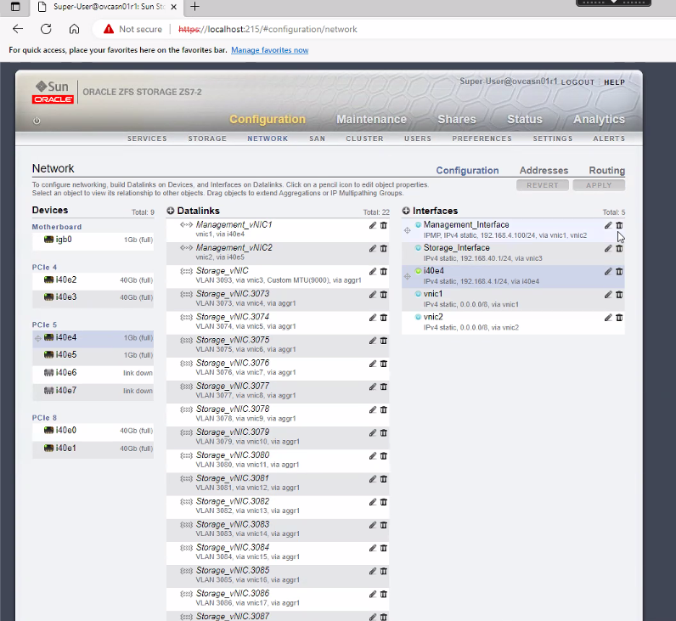
ZFS Storage Management

Slide 44
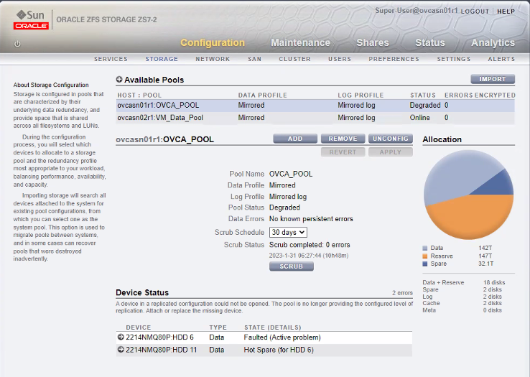
Storage Pools

Slide 45
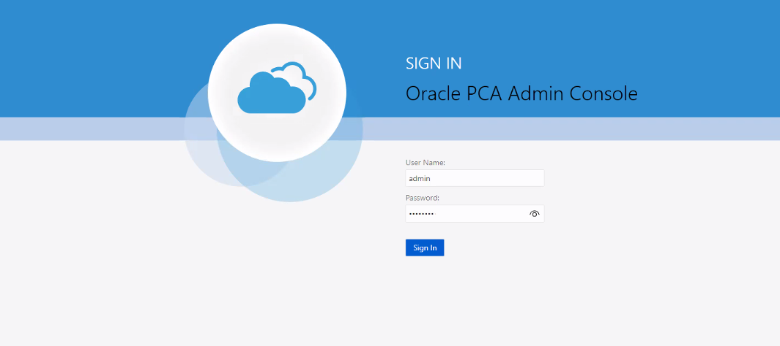
PCA Admin Console

Slide 46
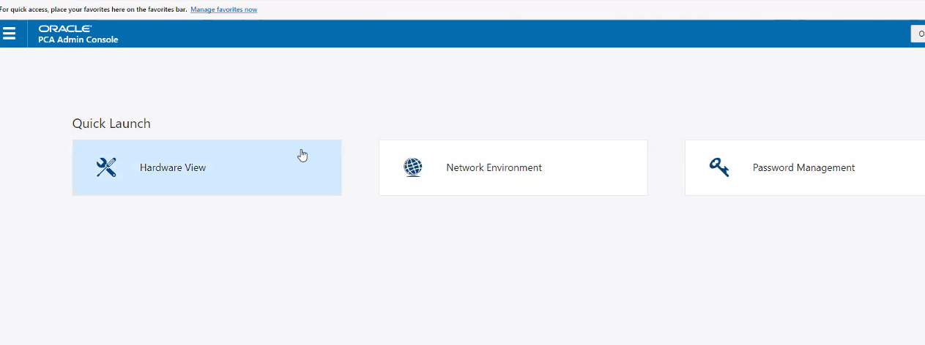
Networking Configurations

Slide 47
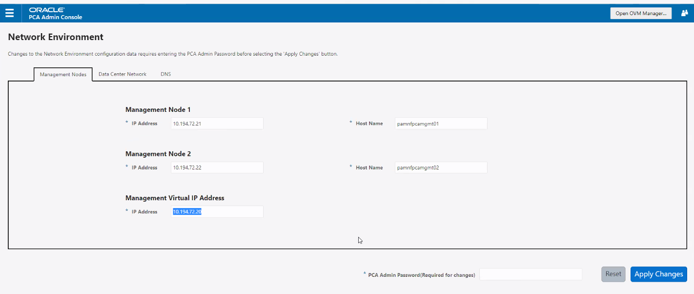
Network Setup

Slide 48
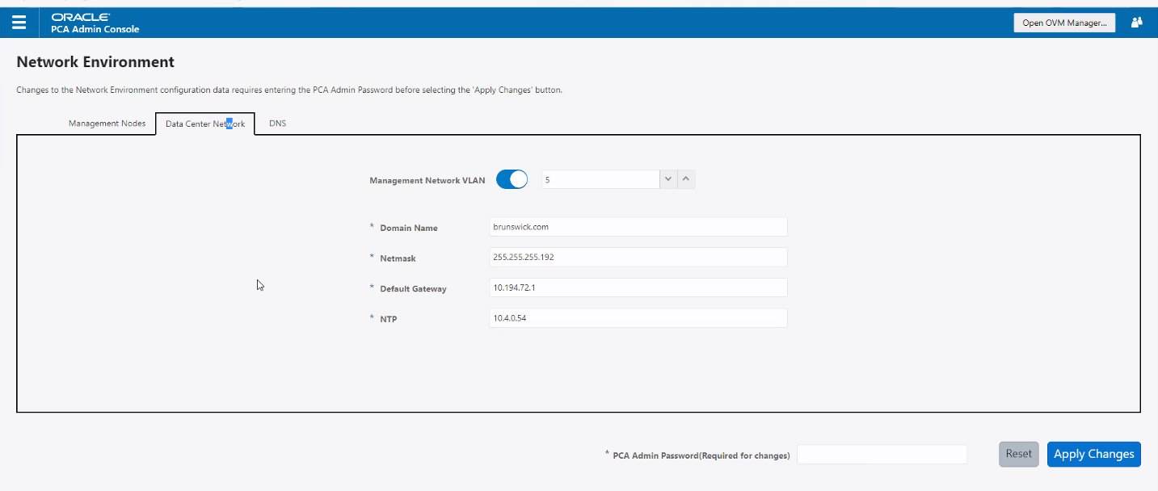
Network Setup – DNS, Netmask, Default Gateway

Slide 49
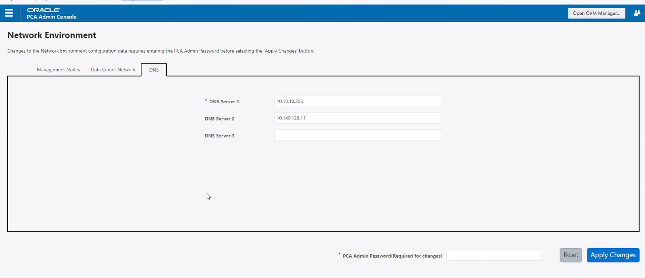
Networking DNS

Slide 50
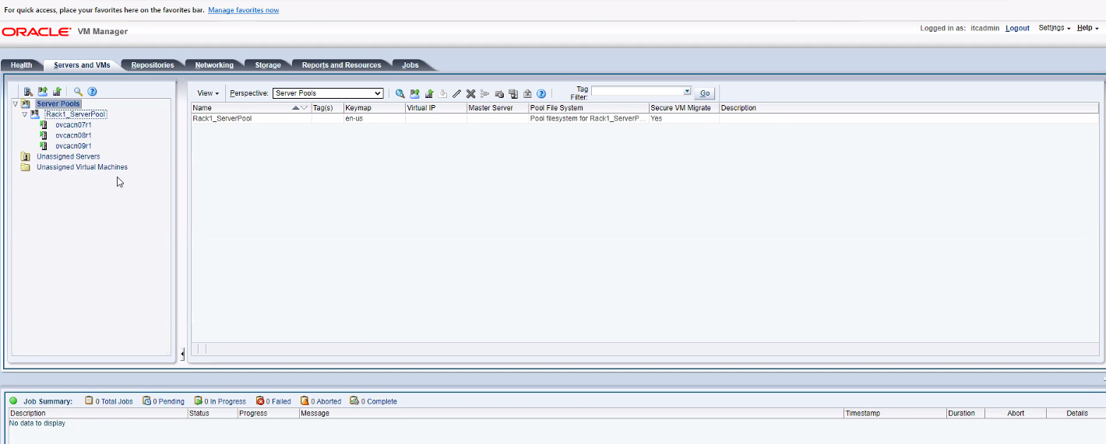
OVM Manager

Slide 51
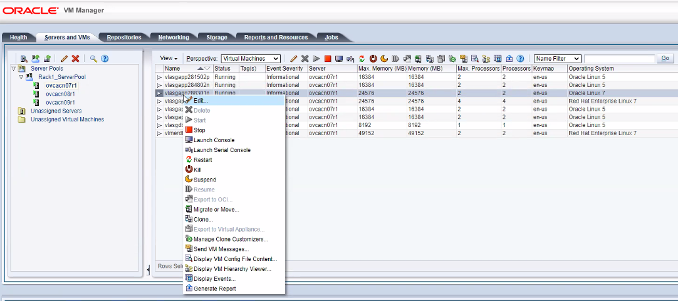
Compute Nodes Options

Slide 52
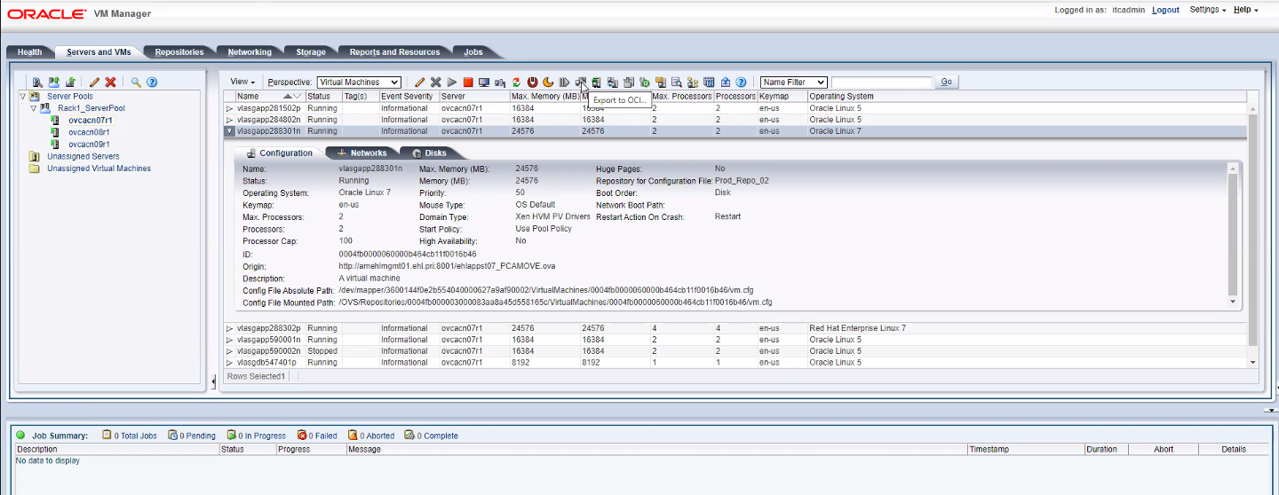
Compute Nodes Setup Details

Slide 53
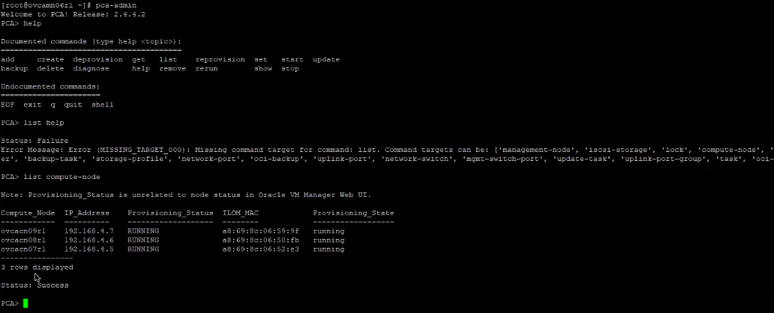
PCA Admin

Slide 54
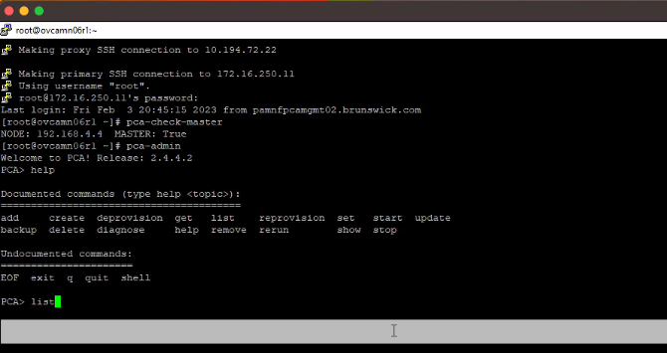
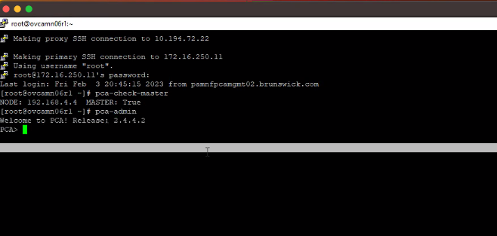
Command Line Interface
pca-check-master

Slide 55
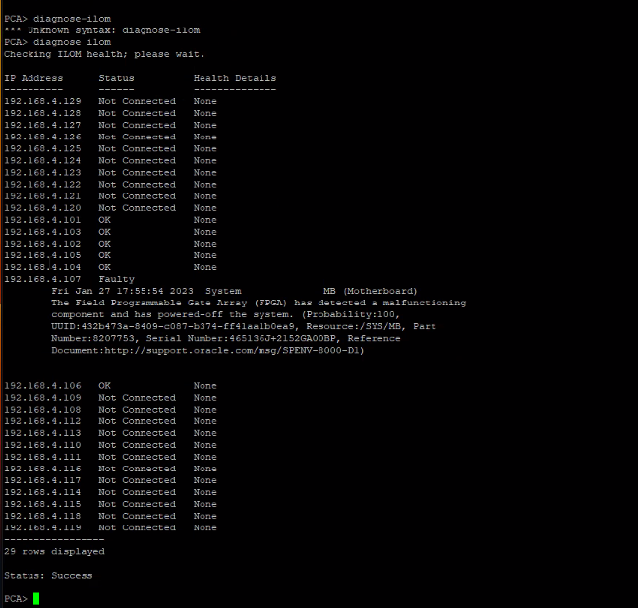
Diagnose ILOM

Slide 56
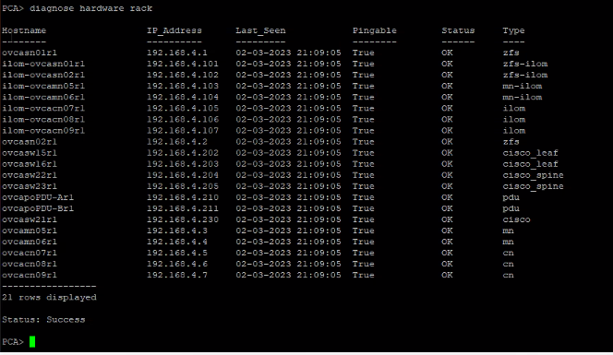
Diagnose Hardware RACK

Slide 57
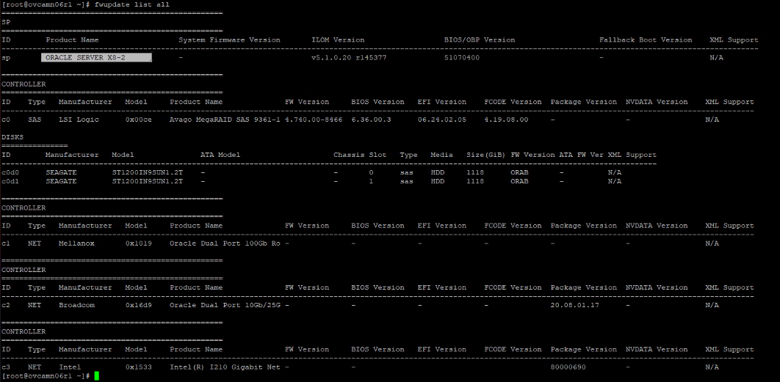
Setup Details

Slide 58
Wrap-UP
Compute@Customer
Separated Networking for Service and Customer Enclaves
Same compatibility as OCI IaaS
Different platforms
Non-Oracle Compatibility
Different Interfaces for Management: ZFS Console, Admin Console, OVM Manager
Command Line Interface for management

Slide 59


Thank You ☺
Questions / Feedback / Training Suggestions
alexandre.af.fagundes@oracle.com
andre.sousa@oracle.com
marcel.lamarca@oracle.com
Ask for help ☺
Notes:
- Agradecer a todos os presentes e reforçar nosso emais e os próximos eventos

